Slide 2
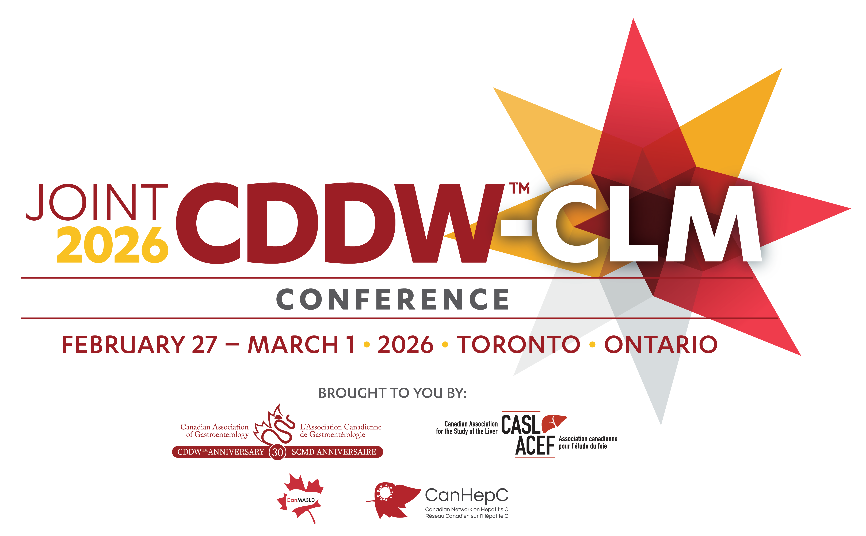


Understanding FibroScan: Applications in Liver Health
Ikram Abow-Mohamed, MD
Resident in Gastroenterology
McGill University, Montréal

Slide 3
TITLE LINE ONE
TITLE LINE TWO

Slide 4
TITLE LINE ONE
TITLE LINE TWO

Slide 6
THANK YOU

